Slide 1
UML Modeling: State Diagram
Instructor: Mehroze Khan

Slide 2
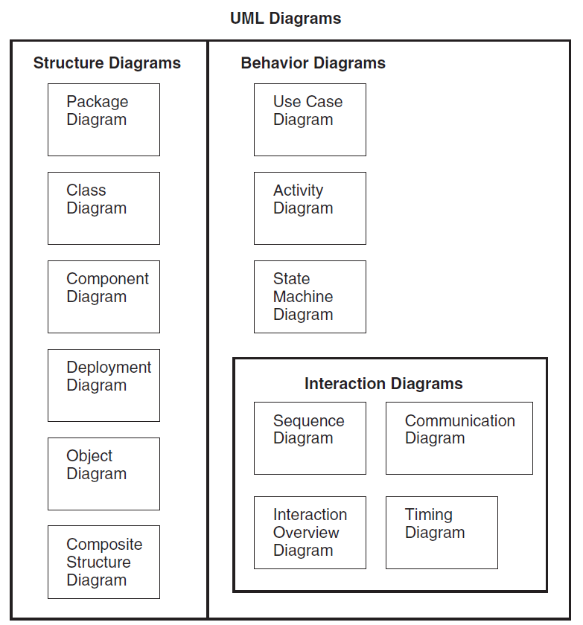
UML Diagrams

Slide 3
State Diagram
The UML includes state diagram notation to illustrate the events and states of things—transactions, use cases, people, and so forth.
A UML state diagram illustrates the interesting events and states of an object, and the behavior of an object in reaction to an event.
A state diagram shows the lifecycle of an object:
What events it experiences
Its transitions
The states it is in between these events.
It is also known as Statechart Diagram or State Machine Diagram.

Slide 4
Events, States and Transitions
An event is a significant or noteworthy occurrence.
For example:
A telephone receiver is taken off the hook.
A state is the condition of an object at a moment in time—the time between events.
For example:
A telephone is in the state of being "idle" after the receiver is placed on the hook and until it is taken off the hook.
A transition is a relationship between two states that indicates that when an event occurs, the object moves from the prior state to the subsequent state.
For example:
When the event "off hook" occurs, transition the telephone from the "idle" to "active" state.

Slide 5
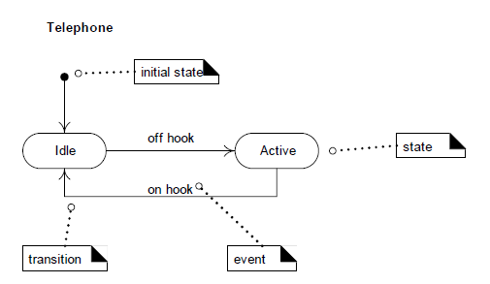
State Diagram for a Telephone
Notes:
Transitions are shown as arrows, labeled with their event. States are shown in rounded rectangles.

Slide 6
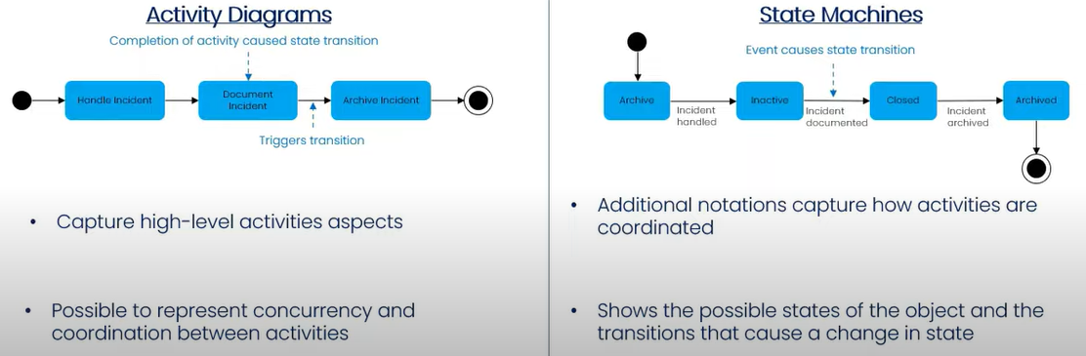
Activity vs State Diagram

Slide 7
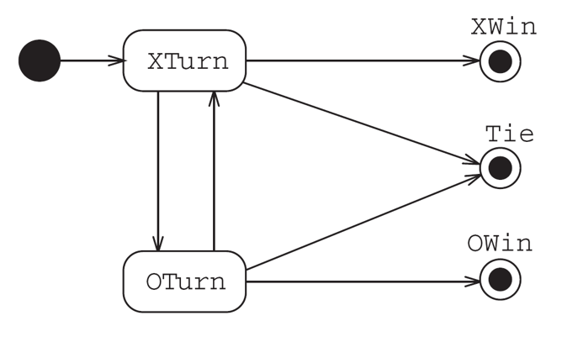
Tic-Tac-Toe Game

Slide 8
Event
An event is an occurrence of a stimulus that can trigger a state transition.
Such as user presses left button or flight 123 departs from Chicago.
Events often correspond to verbs in the past tense (power turned on, alarm set) or to the onset of some condition (paper tray becomes empty, temperature becomes lower than freezing).
Events include error conditions as well as normal occurrences.
For example, motor jammed, transaction aborted, and timeout are typical error events.
There are several kinds of events. The most common are the signal event, the change event, and the time event.

Slide 9
Event
One event may logically precede or follow another, or the two events may be unrelated.
Flight 123 must depart Chicago before it can arrive in San Francisco; the two events are causally related.
Flight 123 may depart before or after flight 456 departs Rome; the two events are causally unrelated.
Two events that are causally unrelated are said to be concurrent; they have no effect on each other.

Slide 10
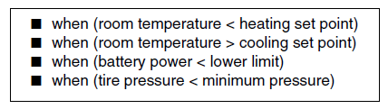
Change Event
A change event is an event that is caused by the satisfaction of a Boolean expression.
The intent of a change event is that the expression is continually tested—whenever the expression changes from false to true, the event happens.
The UML notation for a change event is the keyword when followed by a parenthesized Boolean expression

Slide 11

Time Event
A time event is an event caused by the occurrence of an absolute time or the elapse of a time interval.
UML notation for an absolute time is the keyword when followed by a parenthesized expression involving time.
The notation for a time interval is the keyword after followed by a parenthesized expression that evaluates to a time duration.

Slide 12

State
A state is an abstraction of the values and links of an object. Sets of values and links are grouped together into a state according to the gross behavior of objects.
For example, the state of a bank is either solvent or insolvent, depending on whether its assets exceed its liabilities.
States often correspond to verbs with a suffix of “ing” (Waiting, Dialing) or the duration of some condition (Powered, BelowFreezing).
UML notation for a state—a rounded box containing state name

Slide 13
Transitions
A transition is an instantaneous change from one state to another.
For example, when a called phone is answered, the phone line transitions from the Ringing state to the Connected state.
The transition is said to fire upon the change from the source state to the target state.
The origin and target of a transition usually are different states but may be the same.
A transition fires when its event occurs (unless an optional guard condition causes the event to be ignored).

Slide 14
Transitions
A guard condition is a Boolean expression that must be true in order for a transition to occur.
For example, a traffic light at an intersection may change only if a road has cars waiting.
A guarded transition fires when its event occurs, but only if the guard condition is true.
For example, “when you go out in the morning (event), if the temperature is below freezing (condition), then put on your gloves (next state).”
A guard condition is checked only once, at the time the event occurs, and the transition fires if the condition is true. If the condition becomes true later, the transition does not then fire.

Slide 15
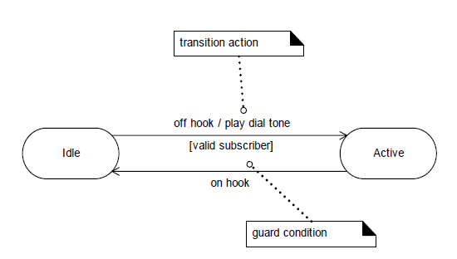
Transition Actions and Guards
A transition can cause an action to fire.
A transition may also have a conditional guard—or boolean test. The transition only occurs if the test passes.

Slide 16
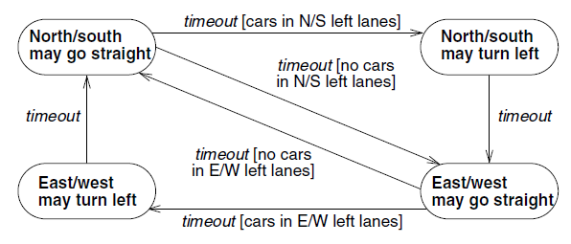
Guarded Transitions for Traffic Lights at an intersection
One pair of electric eyes checks the north-south left turn lanes; another pair checks the east-west turn lanes.
If no car is in the north-south and/or east-west turn lanes, then the traffic light control logic is smart enough to skip the left turn portion of the cycle.

Slide 17
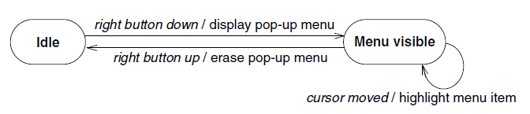
Activity Effects
An effect is a reference to a behavior that is executed in response to an event. An activity is the actual behavior that can be invoked by any number of effects.
The notation for an activity is a slash (“/”) and the name (or description) of the activity, following the event that causes it.
State diagram for a pop-up menu on a workstation. When the right button is pressed, the menu is displayed; when the right button is released, the menu is erased. While the menu is visible, the highlighted menu item is updated whenever the cursor moves.
Event
Activity/Action

Slide 18

Do-Activities
A do-activity is an activity that continues for an extended time.
The keyword do is reserved for indicating an ongoing activity
By definition, a do-activity can only occur within a state and cannot be attached to a transition.
For example, the warning light may flash during the Paper jam state for a copy machine

Slide 19
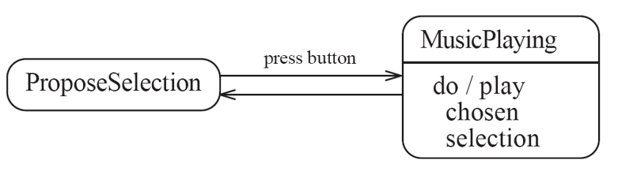
Activities in State Diagram
An activity is something that takes place while the system is in a state.
It takes a period of time.
The system may take a transition out of the state in response to completion of the activity,
Some other outgoing transition may result in:
The interruption of the activity, and
An early exit from the state.

Slide 20
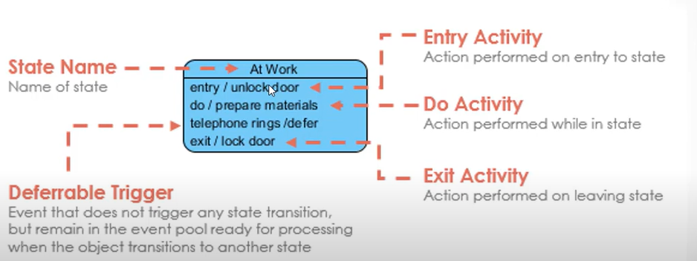
Activities

Slide 21
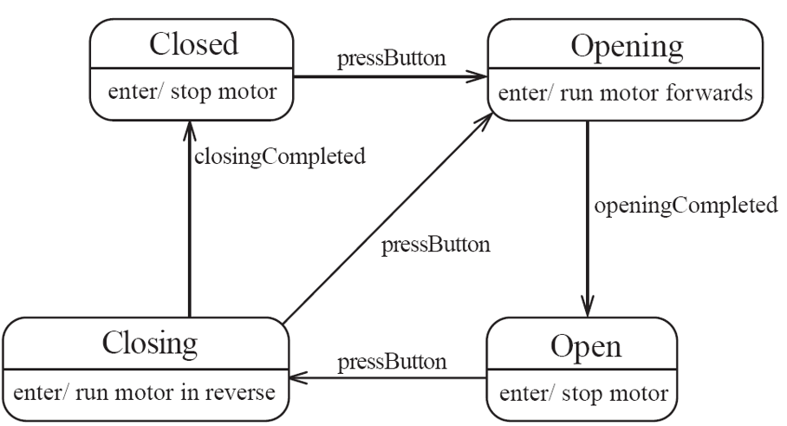
Enter Activity

Slide 22
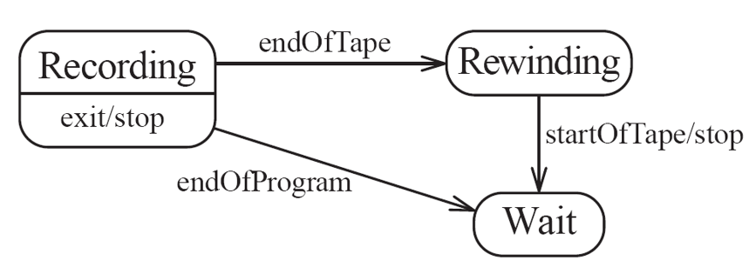
Exit Activity

Slide 23
Subject of State Diagram
A statechart diagram may be applied to a variety of UML elements, including:
Classes (conceptual or software)
Use cases
Since an entire "system" may be represented by a class, it too may have its own statechart diagram.

Slide 24
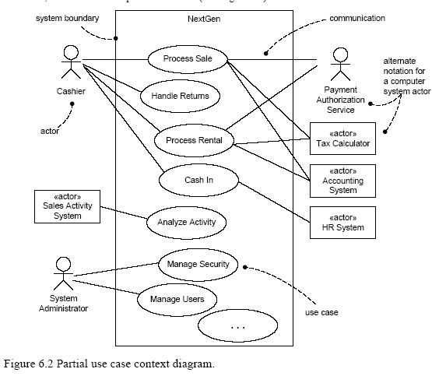
Use Case Diagram of NexGen POS System

Slide 25
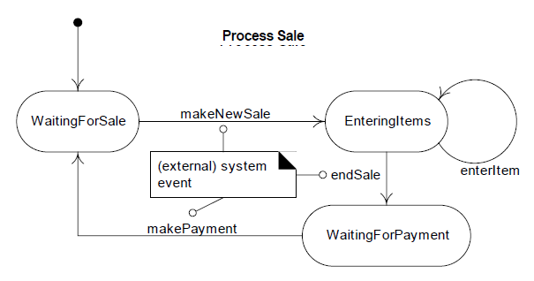
State Diagram for Process Sale

Slide 26
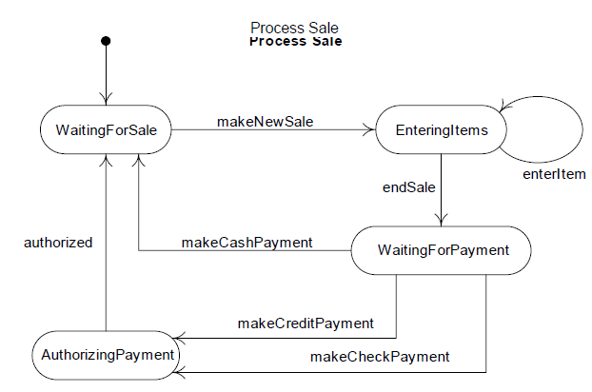
State Diagram for Process Sale

Slide 27
Event Types
It is useful to categorize events as follows:
External event—Also known as a system event, is caused by something (for example, an actor) outside our system boundary. SSDs illustrate external events. Noteworthy external events precipitate the invocation of system operations to respond to them.
ο When a cashier presses the "enter item" button on a POS terminal, an external event has occurred.
Internal event—Caused by something inside our system boundary. In terms of software, an internal event arises when a method is invoked via a message or signal that was sent from another internal object. Messages in interaction diagrams suggest internal events.
ο When a Sale receives a makeLineltem message, an internal event has occurred.
Temporal event—Caused by the occurrence of a specific date and time or passage of time. In terms of software, a temporal event is driven by a real-time or simulated-time clock.
ο Suppose that after an endSale operation occurs, a makePayment operation must occur within five minutes, otherwise the current sale is automatically purged.

Slide 28
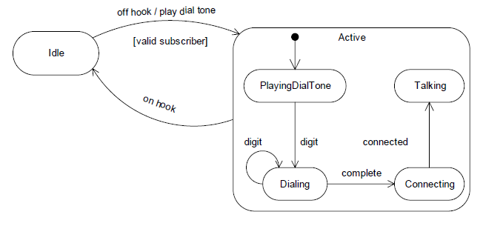
Nested States
A state allows nesting to contain substates; a substate inherits the transitions of its superstate (the enclosing state)
Notes:
When a transition to the Active state occurs, creation and transition into the PlayingDialTone substate occurs. No matter what substate the object is in, if the on hook event related to the Active superstate occurs, a transition to the Idle state occurs.

Slide 29
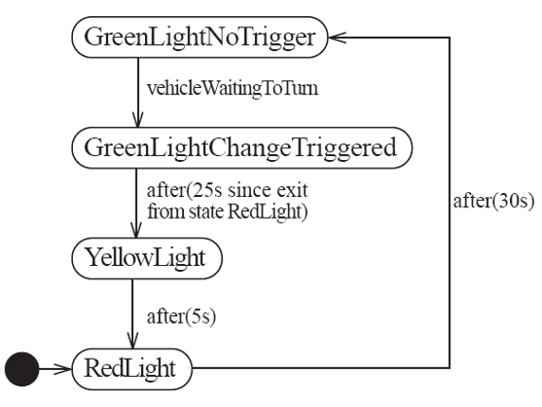
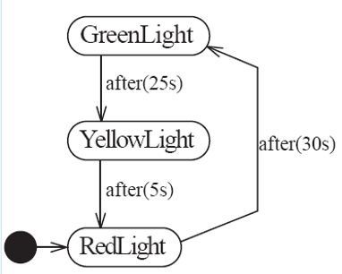
Example of Transitions with Time-Out and Conditions

Slide 30
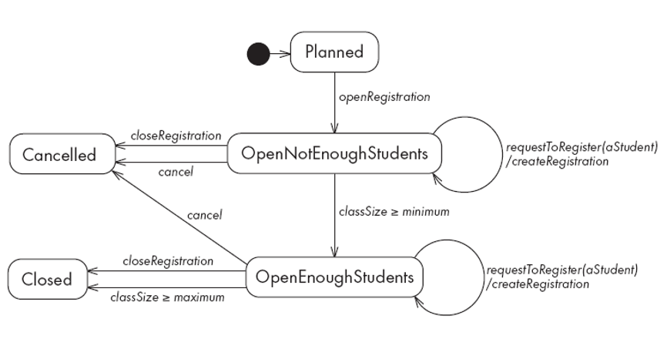
Example of State Diagram with Conditional Transitions

Slide 31
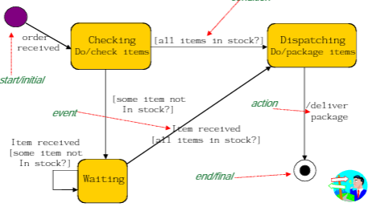
State Diagram for Purchase Order
Event[Condition]/Activity or Action
Condition

Slide 32
References
Larman, Craig. Applying UML and patterns: an introduction to object oriented analysis and design and interative development. Pearson Education India, 2012.
Object-Oriented Analysis and Design with Applications, Grady Booch et al., 3rd Edition, Pearson, 2007.
Timothy C. Lethbridge, Robert Laganaiere, Object-Oriented Software Engineering (2nd Edition), McGraw Hill, 2005
Object-Oriented Modeling and Design with UML, Michael R. Blaha and James R. Rumbaugh, 2nd Edition, Pearson, 2005.

